Slide 1
Data Analysis on a dataset.
Sampath Kumar S H
January 2024

Slide 2
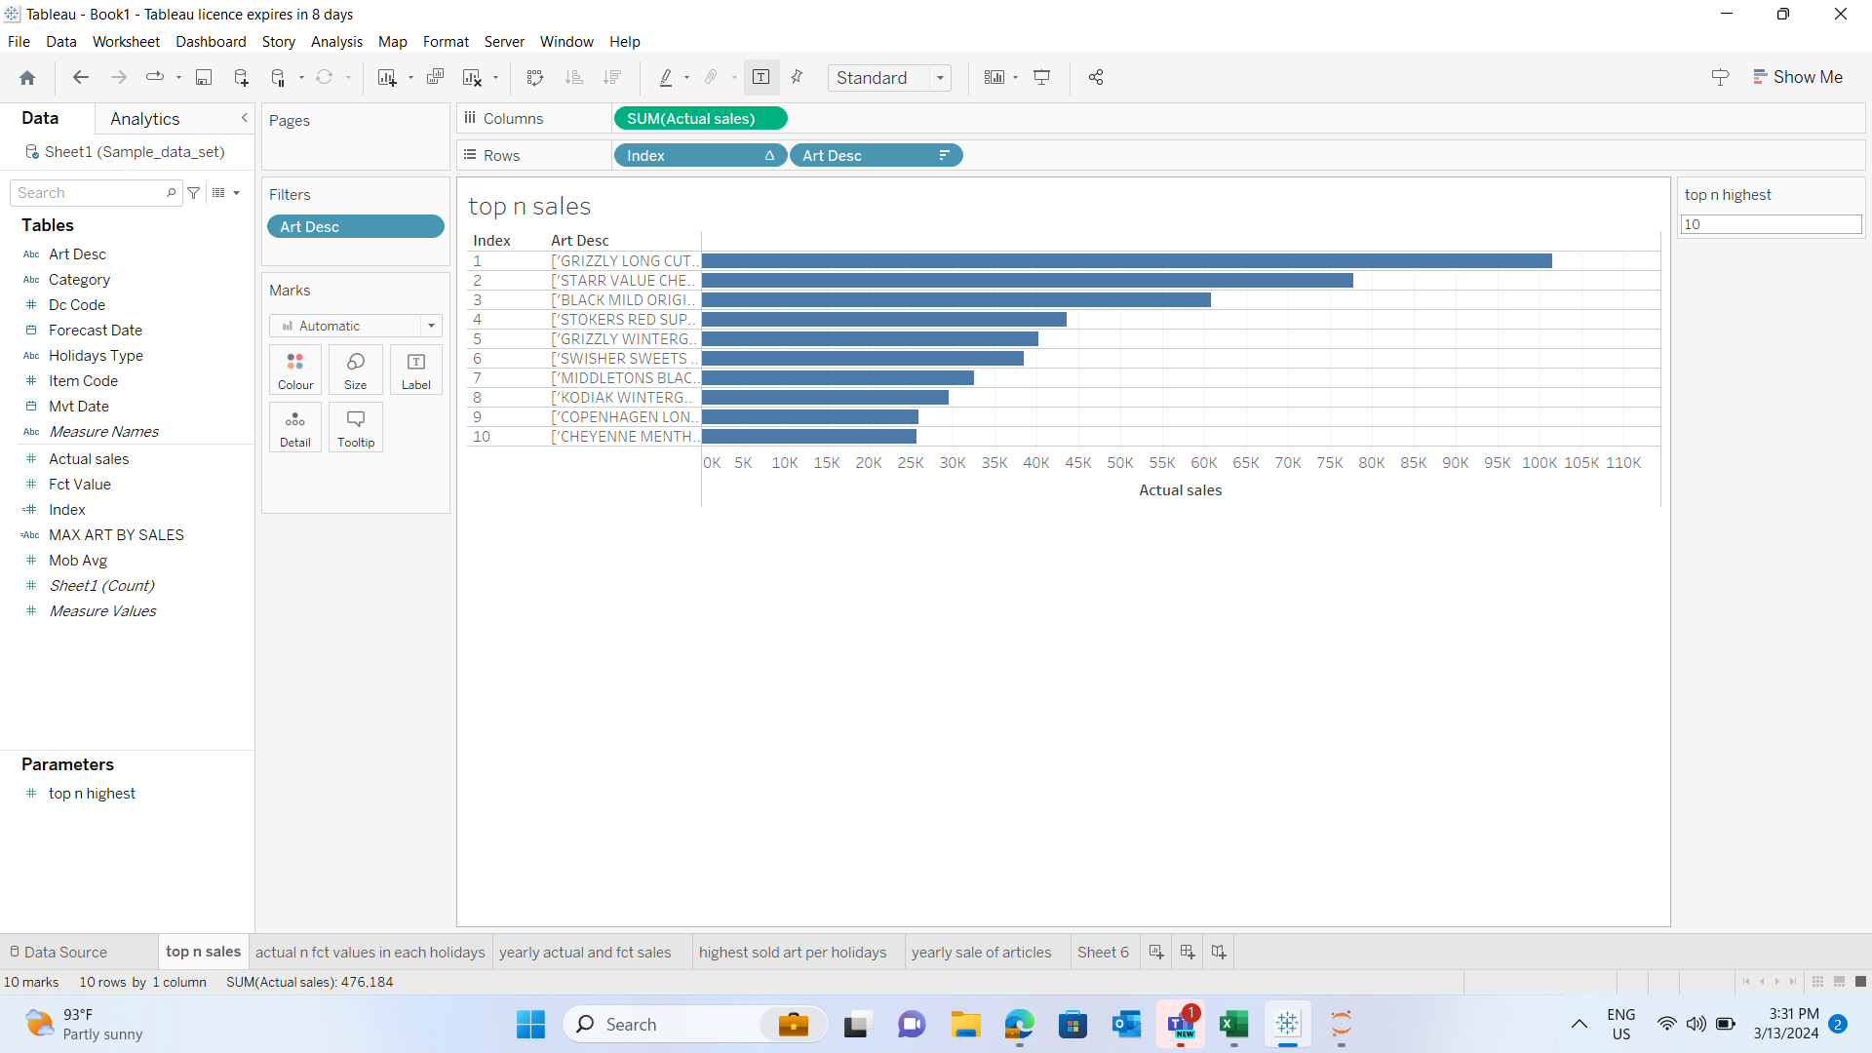
Top 10 highest sales based on the actual sales.

Slide 3
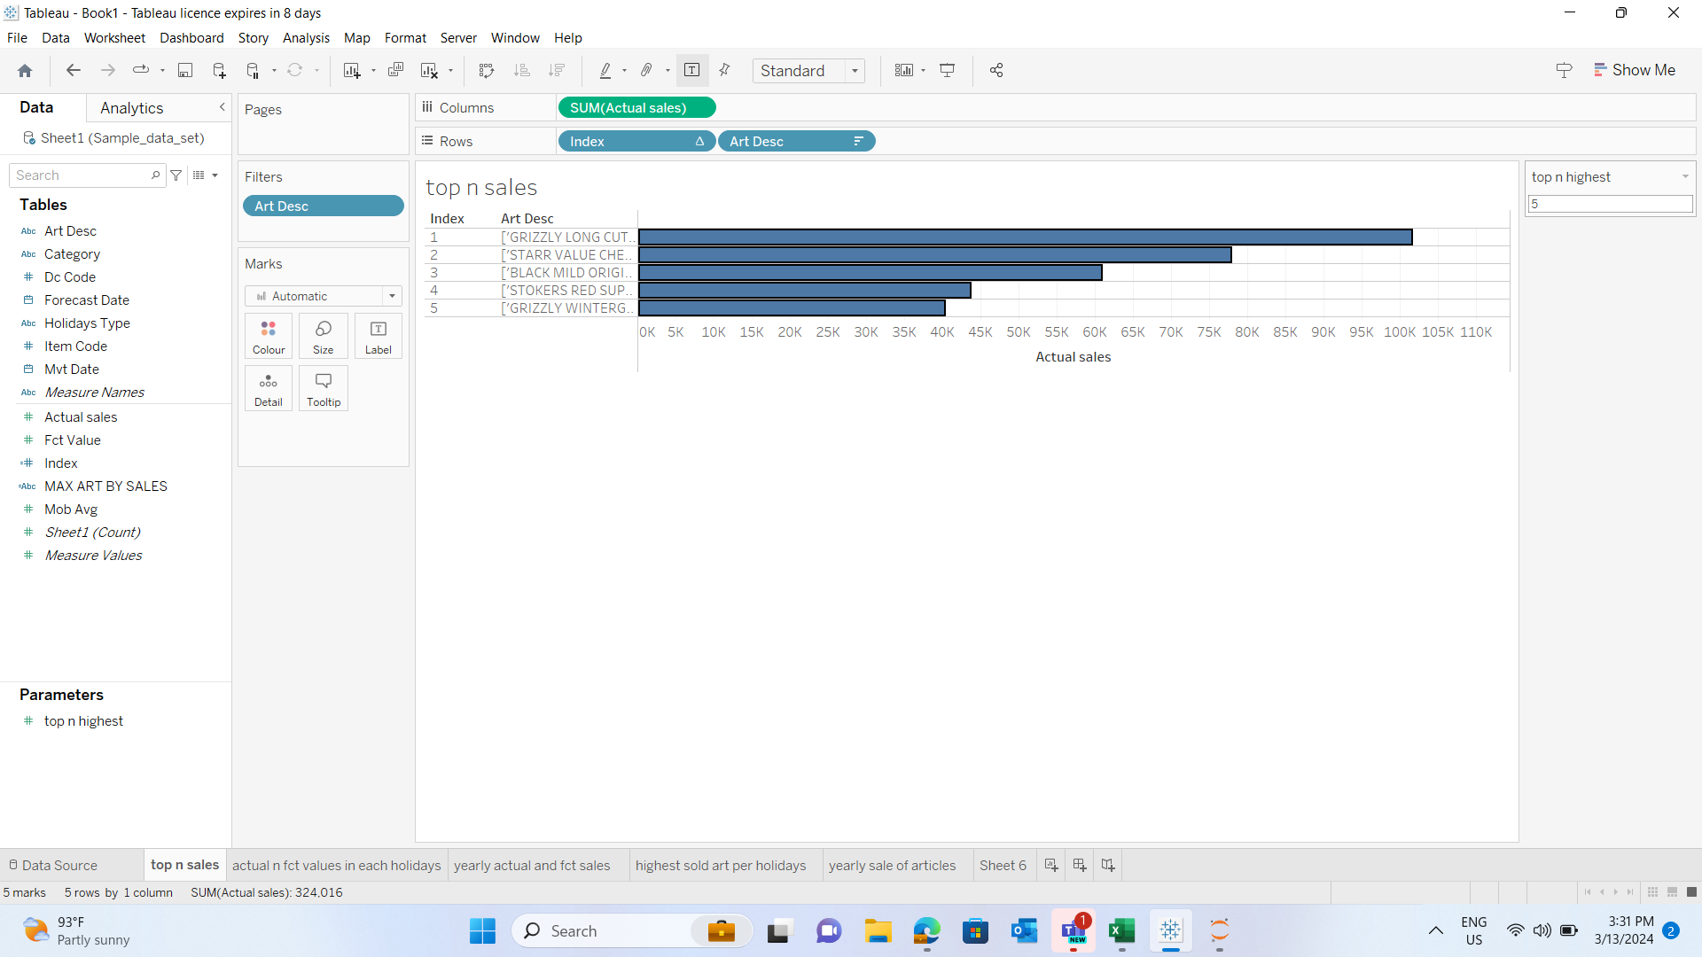
Top 5 highest sales based on the actual sales.

Slide 4
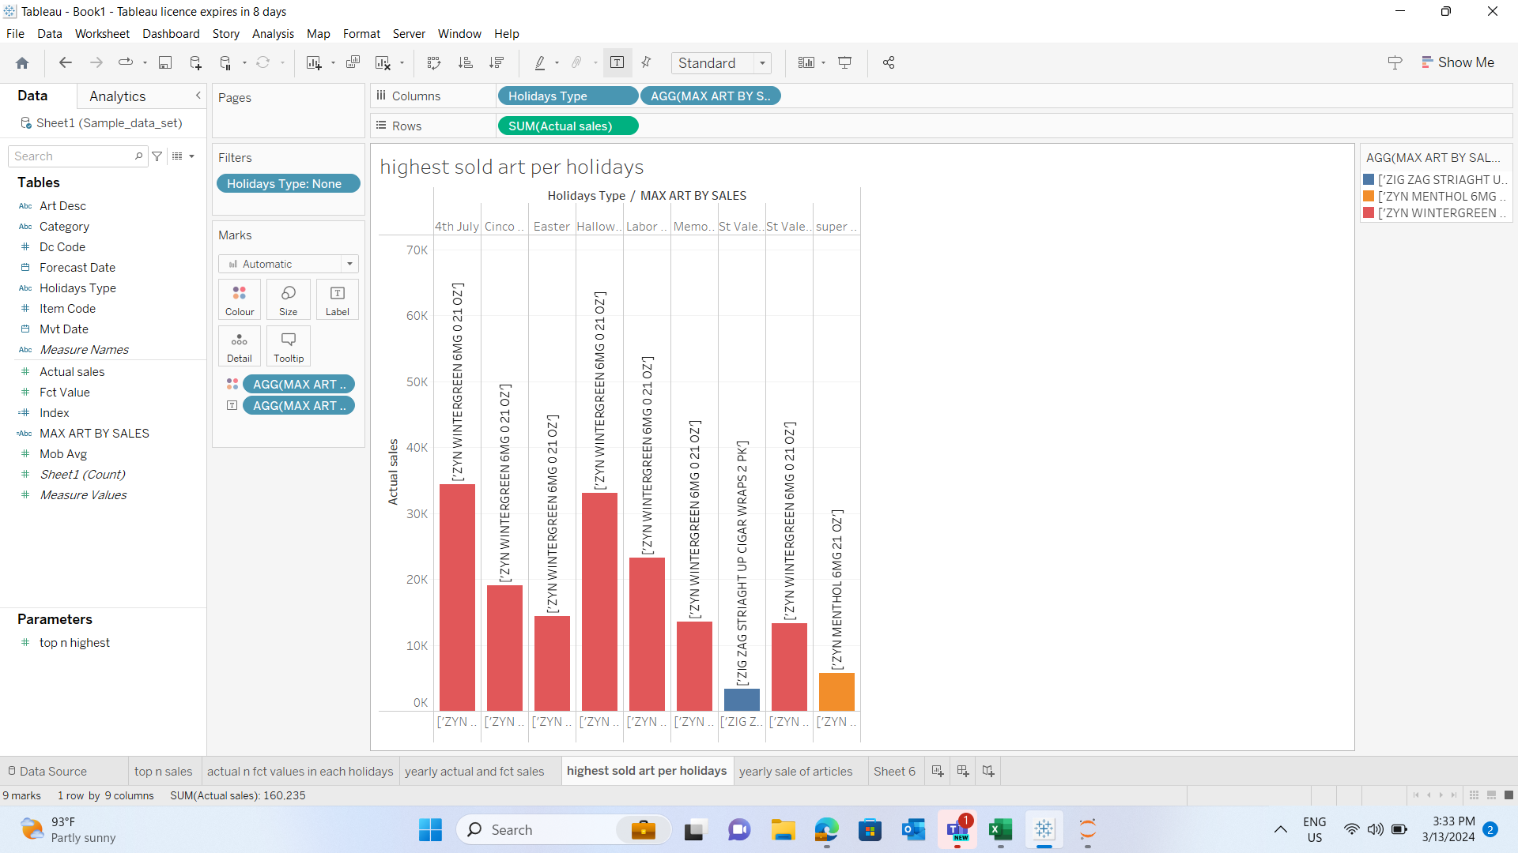
Highest sold article for each holidays by Actual sales.

Slide 5
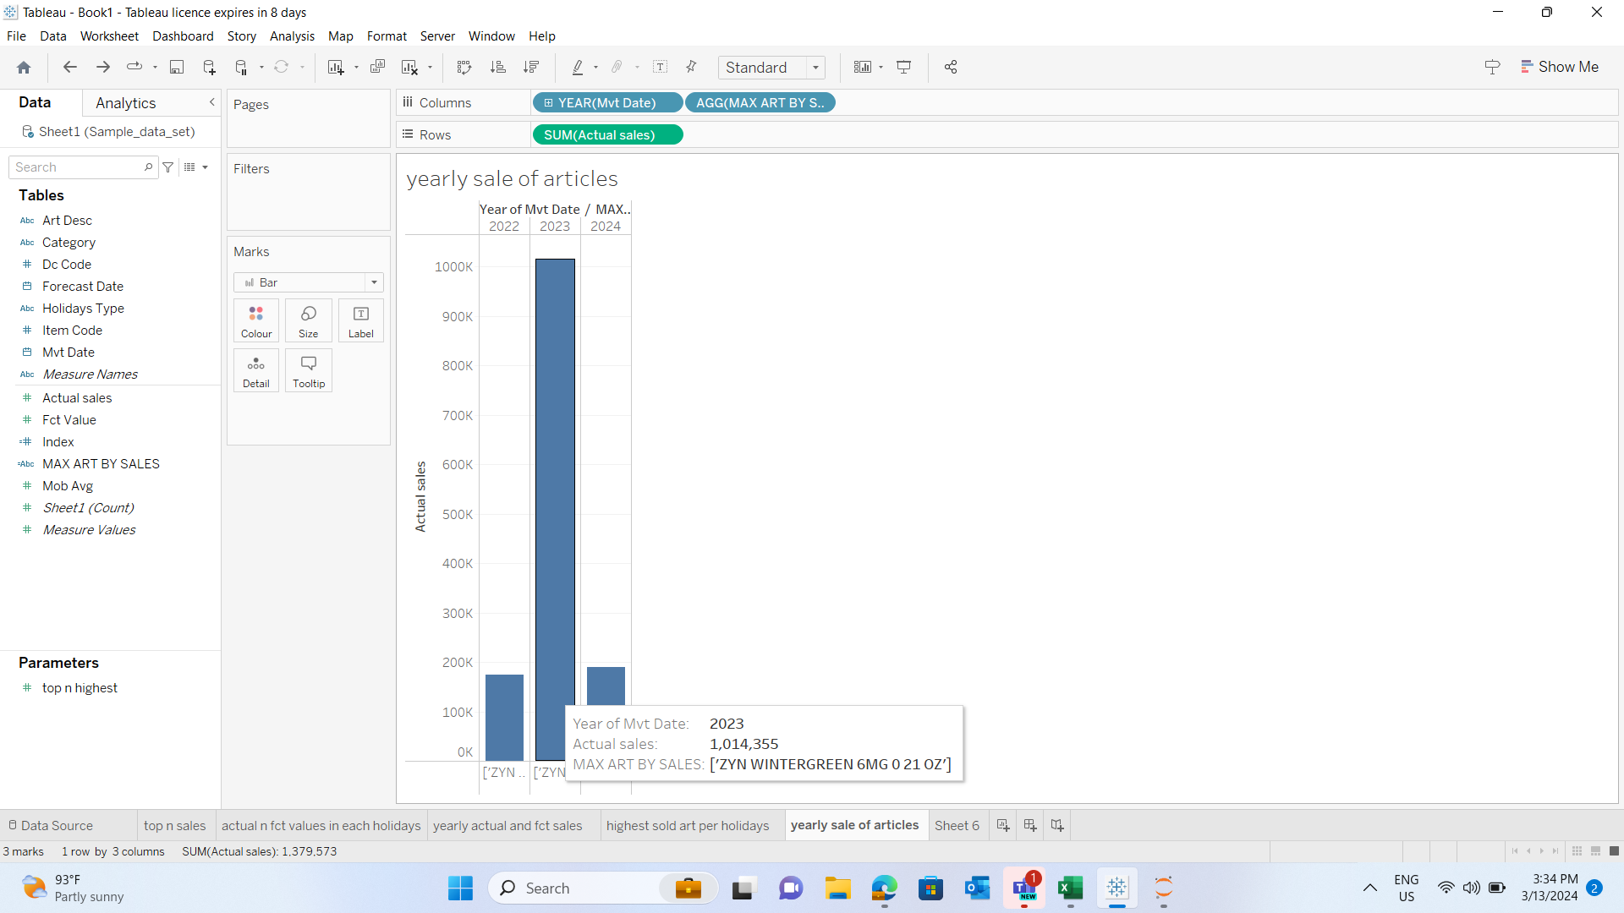
Year wise Article sale based on Actual sales.

Slide 6
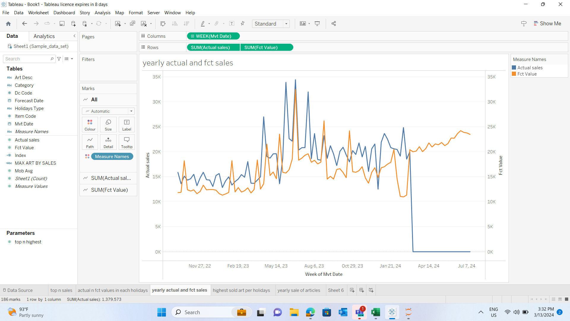
Comparision between Actual sale and forecasted value weekly wise.

Slide 7
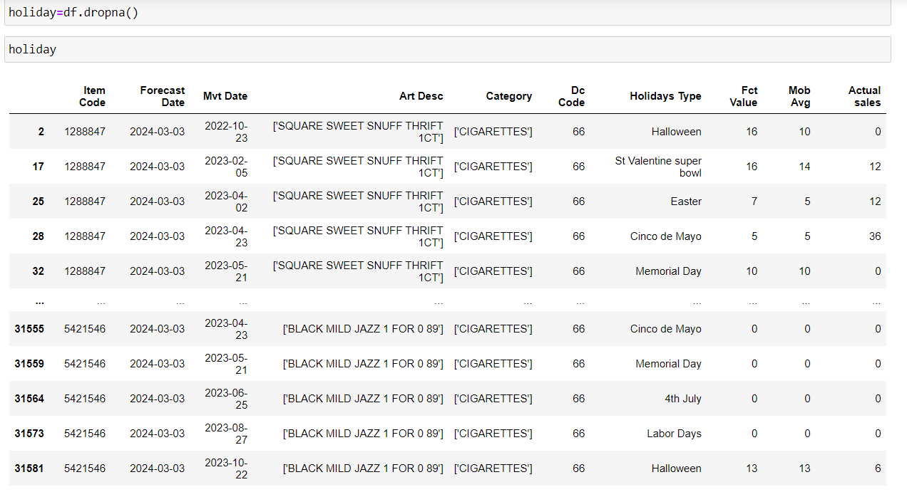
Dropping all the none holidays to analyze data with valid holiday types only.

Slide 8
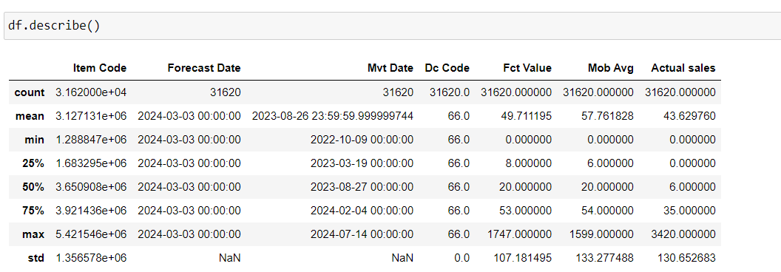
Describing all the columns to know the statistics.

